Slide 1
Discrete decision making
Group task

Slide 2
Space Shuttle Challenger disaster (1/2)
In January 1986, the space shuttle Challenger exploded shortly after launch. An investigation was launched into the cause of the crash and attention focused on the rubber O-ring seals in the rocket boosters. At lower temperatures, rubber becomes more brittle and is a less effective sealant. At the time of the launch, the temperature was 31°F. Could the failure of the O-rings have been predicted? In the 23 previous shuttle missions for which data exists (see file ‘orings.txt’), some evidence of damage due to blow by and erosion was recorded on some O-rings. Each shuttle had two boosters, each with three O-rings. For each mission, we know the number of O-rings out of six showing some damage and the launch temperature. Using binary choice models (probit, logit etc.), find the probability of failure of the O-rings under the following launch temperatures: 32F, 54F, 90F, 71F.

Slide 3
Space Shuttle Challenger disaster (2/2)
Modify the data for binary choice model
Use at least 2 different implementations of models (same languages are allowed).
Quantify the quality of predictions with different metrics. Which solution is the best?
How to solve this problem with classification methods? What is the quality of prediction?
What is the minimal temperature to reduce the probability of failure of the O-rings to almost zero?
Perform the graphical representation of results.
Additional materials: https://en.wikipedia.org/wiki/Space_Shuttle_Challenger_disaster

Slide 4
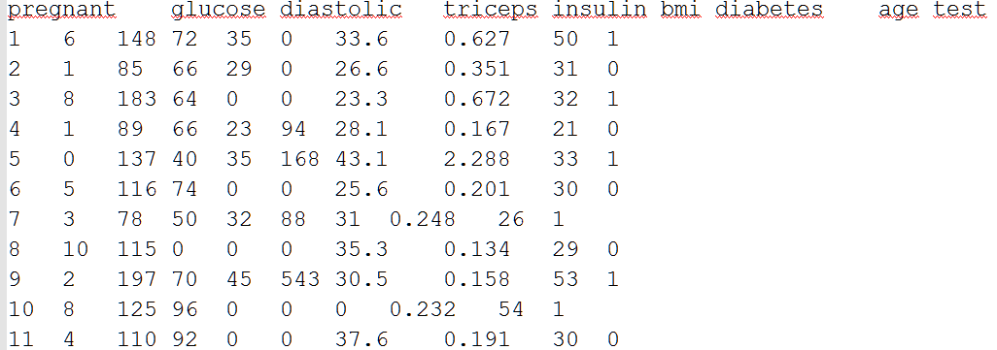
Diabetes among female Pima Indians (1/2)
The National Institute of Diabetes and Digestive and Kidney Diseases conducted a study on 768 adult female Pima Indians living near Phoenix. The purpose of the study was to investigate factors related to diabetes. The data may be found in the dataset ‘pima.txt’.

Slide 5
Diabetes among female Pima Indians (2/2)
Perform simple graphical and numerical summaries of the data. Can you find any obvious irregularities in the data? If you do, take appropriate steps to correct the problems.
Fit a model with the result of the diabetes test as the response and all the other variables as predictors. Can you tell whether this model fits the data?
What is the difference in the odds of testing positive for diabetes for a woman with a BMI at the first quartile compared with a woman at the third quartile, if all other factors are held constant? Give a confidence interval for this difference.
Do women who test positive have higher diastolic blood pressures? Is the diastolic blood pressure significant in the regression model? Explain the distinction between the two questions and discuss why the answers are only apparently contradictory.
Predict the outcome for a woman with predictor values 1, 99, 64, 22, 76, 27, 0.25, 25 (same order as in the dataset). Give a confidence interval for your prediction.
Use different regressions (binary choice) models and quantify the quality of predictions with different metrics. Which solution is the best?
For confidence interval estimation: (Texts in statistical science) Faraway, Julian James-Extending the linear model with R _ generalized linear, mixed effects and nonparametric regression models-Chapman & Hall_CR (attached)

Slide 6
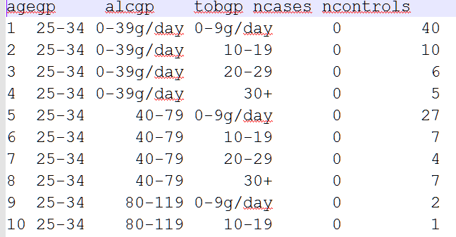
Esophageal cancer (1/3)
The question concerns data from a case-control study of esophageal cancer in Ileet-Vilaine, France. The data is distributed with R and may be obtained along with a description of the variables by:
> data(esoph)
> help(esoph)
or taken from ‘esoph.txt’.

Slide 7
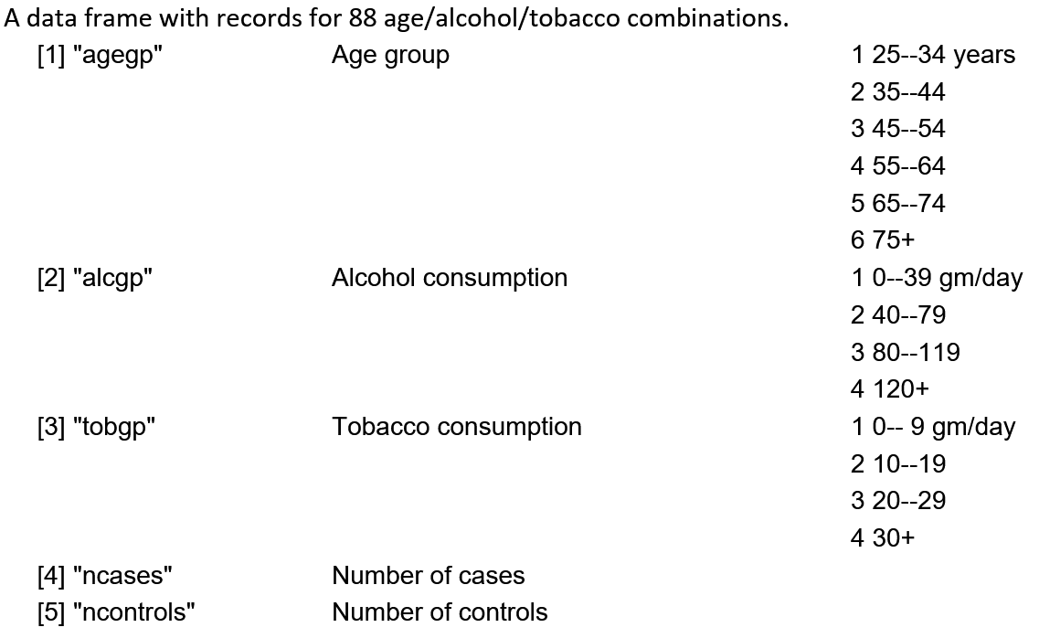
Esophageal cancer (2/3)

Slide 8
Esophageal cancer (3/3)
Fit a binary choice model with interactions between all three predictors. Use backward elimination to simplify the model as far as is reasonable.
Does your final model fit the data? Is the test you make accurate for this data?
Use different regressions (binary choice) models and quantify the quality of predictions with different metrics. Which solution is the best?
Check for outliers in your final model.
What is the predicted effect of moving one category higher in alcohol consumption?
Compute a 95% confidence interval for this predicted effect.
Bearing in mind that this is a case-control study, what can be said about the predicted probability that a 25-year-old who does not smoke or drink will get esophageal cancer?
For confidence interval estimation:
(Texts in statistical science) Faraway, Julian James-Extending the linear model with R _ generalized linear, mixed effects and nonparametric regression models-Chapman & Hall_CR (attached)

Slide 9
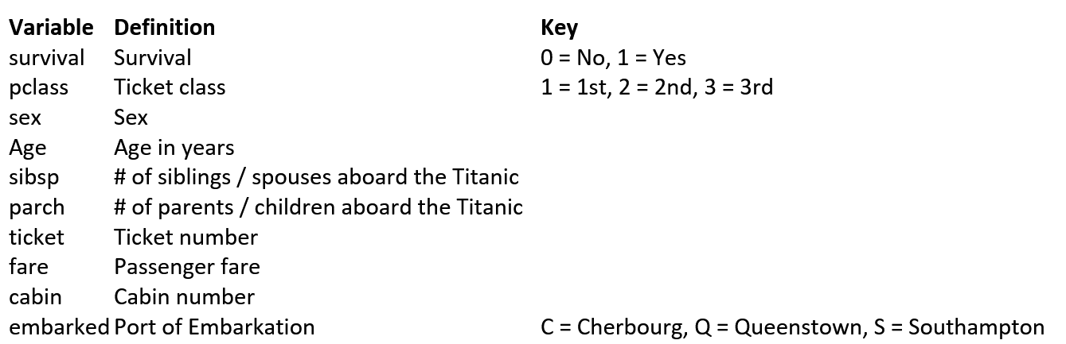
Exploring Survival on the Titanic (1/3)
The Titanic dataset (‘train.csv’) is a collection of data about 889 passengers. With the help of binary choice model, using the first 800 lines as a training set, predict the survival (either 1 if the passenger survived or 0 if they did not) of the remained 89 persons based on features such as the class of service, the sex, the age etc.

Slide 10
Exploring Survival on the Titanic (2/3)
Variable Notes
pclass: A proxy for socio-economic status (SES) 1st = Upper 2nd = Middle 3rd = Lower age: Age is fractional if less than 1. If the age is estimated, is it in the form of xx.5 sibsp: The dataset defines family relations in this way... Sibling = brother, sister, stepbrother, stepsister Spouse = husband, wife (mistresses and fiancés were ignored) parch: The dataset defines family relations in this way... Parent = mother, father Child = daughter, son, stepdaughter, stepson Some children travelled only with a nanny, therefore parch=0 for them.

Slide 11
Exploring Survival on the Titanic (3/3)
Estimate the significance of every of the features, remove the insignificant ones and compare the predictive ability of the simplified model with the original one.
Use different regressions (binary choice) models and quantify the quality of predictions with ROC curve. Which solution is the best?
Additional materials:
Deal with missing data: http://stats.stackexchange.com/questions/67185/assigning-values-to-missing-data-for-use-in-binary-logistic-regression-in-sas

Slide 12
Conditions
Group size: 3-4 members (different background is appreciated)
Time: 3 weeks
Oral presentation of results: explain data, methods and result

